Slide 1
Dr. Brandon T. Payne Deputy State Superintendent Administration & Finance brandon.payne@alsde.edu
ALSDE/DCM
DocuSign User Training
Fully Locally-Funded
Capital Improvement Projects
ALABAMA DEPARTMENT of EDUCATION

Slide 2
Agenda
Introduction
Abbreviations and Key Words
DocuSign Process for Fully Locally-Funded Capital Improvement Projects
Notice to Proceed

Slide 3
Abbreviations & Key Words
DCM: Division of Construction Management in the Department of Finance
SDE: Alabama State Department of Education
LDP: Lead Design Professional is the architect, engineer, or architectural or engineering firm under contract with an awarding authority/owner (must be licensed in AL)
PSCA: Public School and College Authority
Fully Locally-Funded: funds utilized by an LEA for capital improvement other than PSCA
Notes:
You should be familiar with most of these abbreviations.
Projects utilizing any PSCA funds cannot be processed using Fully Locally-Funded construction contract documents. If a project is funded with PSCA funds you must complete the PSCA forms.
PSCA forms can be found on DCM’s website.

Slide 4
DocuSign Process
for
Lead Design Professionals (LDP)
Effective October 1, 2022, all Fully Locally-Funded Construction Contracts must be completed through the DocuSign process; links to these forms shall be available from DCM’s website.
These documents include:
Agreements Between the Owner and Architect/Engineer
Amendments to the Agreements Between the Owner and Architect/Engineer
Construction Contracts
Change Orders
ALABAMA DEPARTMENT of EDUCATION
Notes:
Starting October 1st all Fully Locally-Funded Construction Contract documents must be completed using DocuSign.
Links to these forms will be available on DCM’s website.
We will allow a grace period that will be discussed during this training.

Slide 5
How to be Prepared
Please add docusign.net to your trusted domain list and add dse_NA4@docusign.net to your email safe senders list so notifications are not accidently sent to a junk inbox.
It is unnecessary to have a DocuSign account in order to use this; however, you may sign up for a free DocuSign account at https://go.docusign.com/o/free, in order to track documents you are reviewing, signing or have completed.
Notes:
Please share this information with everyone you process current construction contracts documents with, Surety Companies, Insurance Companies, Contractors, etc.
LEAs have been provided with this information as well.
We highly recommend setting up a DocuSign account. This will assist you in tracking documents you have initiated.

Slide 6
How does it work?
Each assigned participant will perform their required action in sequence, not parallel nor at the same time as each other.
Only the participant whose turn it is may perform an action in the document.
All other participants for whom it is not their turn may view the status of the document but cannot perform an action in the document.
It is very important to complete your required action in a timely manner. You will receive a reminder every two (2) days.
Notes:
Participants receive the document in order and the process is in sequence of that order, multiple participants will not receive the document for review at the same time. Each participant must complete their turn before the document proceeds to the next participant in line.
It is very important that each participant completes there required action in a timely manner. Reminders will be sent every two (2) days.

Slide 7
Choosing the Right Form
There are six (6) forms:
Agreements Between the Owner and Architect/Engineer
Amendments to the Agreements Between the Owner and Architect/Engineer
Construction Contracts <$50,000 (Does not require Bonds)
Construction Contracts >$50,000 (Requires Bonds)
Change Orders >10 % of Original Contract Value and/or Adding Days (Requires Surety and Owner Legal)
Change Orders <10% of Original Contract Value, Deductive and/or Adding Days (Requires Surety Only)
If you are unsure which form to use, please contact our office. Using the incorrect form could result in the document being voided.
Notes:
This is very important, choosing the incorrect document could result in the document being voided.
Change Orders have three (3) different forms due to the requirements of surety and owner legal. Some LDPs prefer to have surety on all change orders deductive or additive (<10% of the contract value). This will still be accepted. However, if the cumulative change order amount is greater than 10% of the original contract value, the owner’s legal e-signature will be required.
If you are unsure of which form you should use, please contact our office.

Slide 8
Order of Action by Form
Agreement Between the Owner and Architect/Engineer
LDP Firm – Form Filler (initiator)
LDP Firm – Signer
Owner – Draft Reviewer
SDE - Reviewer
CSFO – Local Budget Reviewer
Owner – Signer (Superintendent)
SDE - LEA Regional Accountant
SDE – Dr. Brandon T. Payne – Deputy State Superintendent
SDE – Dr. Eric G. Mackey – State Superintendent of Education
Amendment to an
Agreement Between the Owner and Architect/Engineer
LDP Firm – Form Filler (initiator)
LDP Firm – Signer
Owner – Draft Reviewer
SDE - Reviewer
CSFO – Local Budget Reviewer
Owner – Signer (Superintendent)
SDE - LEA Regional Accountant
SDE – Dr. Brandon T. Payne – Deputy State Superintendent
SDE – Dr. Eric G. Mackey – State Superintendent of Education
Notes:
This shows the order of participants that each document will go in sequence.
O/A Agreements and Amendments to O/A Agreements

Slide 9
Order of Action by Form
Construction Contract
LDP Firm – Form Filler (initiator)
Construction Contractor – Reviewer
Construction Contractor – Signer
Surety Company Signer – Performance and Payment Bonds
Contractor Signer – Post Surety
LDP Firm – Attachment Reviewer
Owner – Draft Reviewer
DCM - Reviewer
SDE - Reviewer
CSFO – Local Budget Reviewer
Owner – Signer (Superintendent)
SDE - LEA Regional Accountant
SDE – Dr. Brandon T. Payne - Deputy State Superintendent
SDE – Dr. Eric G. Mackey – State Superintendent of Education
Assigned DCM Inspectors – Receives a Copy
Change Order
LDP Firm – Form Filler (initiator)
LDP Firm – Form Signer
Construction Contractor – Reviewer
Construction Contractor – Signer
Surety Company Signer (if the change is an increase)
SDE - Reviewer
Owner – Draft Reviewer
Owner – Legal Counsel (if 10% or greater than original contract amount)
CSFO – Local Budget Reviewer
Owner – Signer (Superintendent)
SDE - LEA Regional Accountant
SDE – Dr. Brandon T. Payne - Deputy State Superintendent
SDE – Dr. Eric G. Mackey – State Superintendent of Education
Notes:
Construction Contracts and Change Orders

Slide 10
Before You Get Started
The LDP Form Filler will initiate and complete the construction contract forms.
Make sure you know the full names and email addresses for the correct person to perform the assigned roles before starting this process. You cannot initiate the document without this information. You must enter a first and last name for each person. A firm name, company name, owner entity name, title, TBD, etc., will not be acceptable.
Construction Contractor – Reviewer (Construction Contracts and CO ONLY)
Construction Contractor – Signer (Construction Contracts and CO ONLY)
Surety Company Signer – Performance and Payment Bonds (Construction Contracts >$50,000 and CO ONLY)
LDP Firm – Signer (O/A Agreements ONLY)
LDP Firm – Reviewer (Construction Contracts and CO ONLY)
Owner Reviewer – Terms Reviewer
Chief School Financial Officer (CSFO) – Budget Approval
Owner (Superintendent)
Code of Alabama 16-13A-8 designates the Superintendent the authority to expend funds; this authority cannot be transferred without express Board action.
Notes:
We recommend that you gather the full names and email address for the correct person to perform each assigned role before starting the document process. You can not initiate a document without this information.
We will not accept “firm name” “company name” “owner entity name” “title” “TBD” (to be determined), only full names will be acceptable.
The Code of Alabama designates the Superintendent the authority to expend funds; this authority cannot be transferred without express Board action.

Slide 11
Recommendation
It is our recommendation that you complete the document that you are wanting to initiate in DocuSign in either PDF format or Hard Copy format and use that copy to complete the required data fields in DocuSign. This is just a recommendation and is not a requirement. Over time you may no longer need to do this.
Notes:
This is just a recommendation to adjust to completing these documents electronically. It is not a requirement and may not be needed over time.

Slide 12
The “Validation Access Code"
Once the roles are filled and the Start button is selected, the LDP Form Filler will receive an "Access Code" via email. This code is used to start the document process and is required to perform reviews and initial revisions made by anyone in the flow process. The code is only used by the LDP Form Filler, no one else receives the code or uses the code. The LDP Form Filler must keep up with this code, it will be different for each document you start. We recommend printing it off or electronically filing it with other documents related to the project.
Notes:
This is very important.
All documents can be returned to the LDP Form Filler for revisions, there are a lot of collaborative fields and other participants can make changes.
If a participant makes changes the LDP Form Filler will be required to enter this code to access the document to review the revisions.
We recommend that you keep a log or file of each projects validation access code until you receive a fully executed document.

Slide 13
LDP Form Filler
Enter the "Access Code" on the webpage, then on the next webpage select “Continue”.
The LDP Form Filler enters data in the required fields and uploads the required documents.
Collaborative fields are initially filled out by the LDP Form Filler and are outlined in red for you since they are your required fields. Optional fields are outlined in gray. Collaborative fields will show as having pink backgrounds in appearance for all other recipients except you. If a workflow recipient besides the LDP Form Filler makes changes to any collaborative field, all previous recipients (starting with the LDP Form Filler, then the other participants, if any, in sequence) will receive requests to initial the changes and/or make further changes.
You may choose to “Finish Later” by clicking on “Other Actions” in the dropdown menu.
Notes:
The LDP Form Filler is a very important role. The LDP Form Filler will enter most of the data and upload the required documents.
When revisions are made the document will be returned directly to you for review.

Slide 14
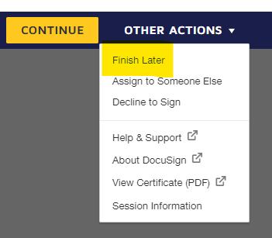
LDP Signer
Select the “Start” button inside the email, then select “Continue” on the ensuing website.
A “Questions” box will appear, it contains our phone number if you need assistance. Click “Continue”.
Review the document and attachments. If the document is acceptable select “Yes” and apply your e-signature by selecting the rectangular “Sign” button on the signature.
Select “Finish” when you are ready for the envelope to forward to the next recipient.
You may also choose to “Finish Later” by clicking on “Other Actions” in the dropdown menu.
If any data is missing or needs revisions, follow the Revisions/Return Instructions.
Notes:
LDP Signer is required on O/A Agreements, Amendments to O/A Agreements and Change Orders.

Slide 15
LDP Reviewer (Contracts)
Select the “Start” button inside the email, then select “Continue” on the ensuing website.
A “Questions” box will appear, it contains our phone number if you need assistance. Click “Continue”.
Review the document and attachments. If the document is acceptable select “Yes”.
Select “Finish” when you are ready for the envelope to forward to the next recipient.
You may also choose to “Finish Later” by clicking on “Other Actions” in the dropdown menu.
If any data is missing or needs revisions, follow the Revisions/Return Instructions.
Notes:
LDP Reviewer role is required for Construction Contracts only.

Slide 16
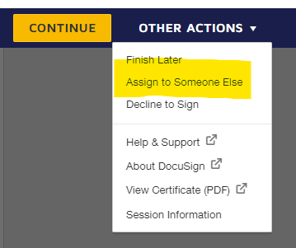
It’s not me?
If you are not the correct person to perform the review action: After selecting the “Start” button in the email, select “Continue” on the ensuing website and then you may assign the role to someone else within your organization by selecting “Assign to Someone Else” from the “Other Actions” drop-down menu. Please note that merely forwarding the email does not assign the role to someone else.
Notes:
If you receive a document and you are not the correct person to perform the review you can assign the role to someone else.
Forwarding the email to someone does not change the role and the originally assigned person will receive any revisions that are made.

Slide 17
Revisions/Returns
Any required fields are outlined in red, and any optional fields are outlined in gray.
Collaborative fields have pink backgrounds; such fields are initially filled out by the LDP Form Filler. All participants can change these fields during the process.
If you make changes to any collaborative field or return field and complete your turn, the document will return to the LDP Form Filler to review and initial the change. It will then go through and request review and initials from all participants that haven’t seen the change in the sequence.
When returns are viewed by the LDP Form Filler the required fields remain active. The LDP Form Filler must locate the change/comment by looking for initials on the far-right side of the document.
Notes:
If revisions are made the document goes directly back to the LDP Form Filler. Note: The participant must complete their assigned role and click finish.
When revisions are received by the LDP Form Filler, the form filler must locate the change or comment made. Look for initials on the far-right hand side.

Slide 18
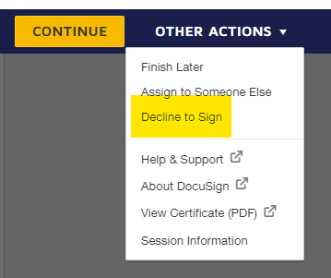
Decline to Sign or Void
Selecting “Decline to Sign” or “Void” would terminate the document and render the draft unusable.
Notes:
If anyone in the process selects decline to sign or void the document will be unusable.
We can not retrieve the document after this action is taken.
The LDP Form filler will have to start the document again in DocuSign.

Slide 19
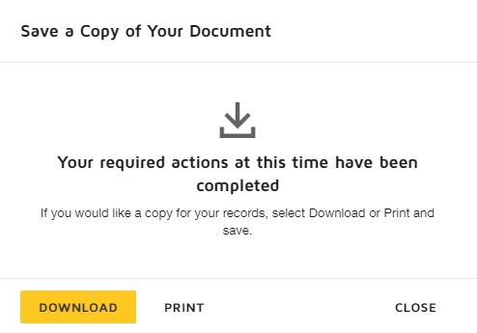
Fully Executed
You will have the option at the end of your turn to download a copy of the document.
Once all recipients have completed their turn, each will automatically receive either an emailed link to a fully signed document, OR an emailed notice of a voided document.
Notes:
All assigned participants will receive either an email link to the completed document OR an email notice of a voided document.

Slide 20
Notice to Proceed
Notice to Proceeds are currently being issued by the LEA (Owner) or LDP. This will continue. Please ensure that all Notice to Proceeds are issued. This is a vital piece for projects to be completed on time.
Notes:
NTPs have been issued by the LEA or LDP.
This will continue.
Please ensure that the NTPs are issued. This is a vital piece for projects to be completed on time.

Slide 21
Transition/Grace Period
We understand that there are original hard copy documents in the routing process. We will accept original hard copies for a short duration of time to allow these documents to be submitted.
The hard deadline will be for Agreements between the Owner and Architect/Engineer and Construction Contracts dated on or after October 1, 2022. These documents will be returned to the LDP for submission through the DocuSign process.
Notes:
We are aware that there are documents currently being routed hard copy and we will allow a transition/grace period for these documents.
Our hard deadline will be for O/A Agreements and Construction Contracts dated on or after October 1, 2022. These documents will be returned for submission through the DocuSign process.

Slide 22
Test O/A Agreement
Now we will perform a test of the Agreement Between the Owner and Architect/Engineer.
If you have any questions or need assistance, please contact:
Alabama State Department of Education
School Architect Section
334-694-4602
jragan@alsde.edu
Notes:
Now we will perform a walk through of an O/A Agreement.
If you need anything or have any questions, please contact our office.

