Slide 1
Dr. Brandon T. Payne Deputy State Superintendent Administration & Finance brandon.payne@alsde.edu
ALSDE / DCM
DocuSign User Training
Fully Locally Funded
Capital Improvement Projects
ALABAMA DEPARTMENT of EDUCATION

Slide 2
Agenda
Abbreviations and Key Words
DocuSign Process for Fully Locally Funded Capital Improvement Projects
Notice to Proceed

Slide 3
Abbreviations & Key Words
DCM: Division of Construction Management in the Department of Finance
SDE: Alabama State Department of Education
LDP: Lead Design Professional is the architect, engineer, or architectural or engineering firm under contract with an awarding authority/owner (must be licensed in AL)
PSCA: Public School and College Authority
Fully Locally Funded: funds utilized by an LEA for capital improvement other than PSCA
Notes:
These are abbreviations and key words used in this training.

Slide 4
DocuSign Process
for
Local Education Agency (LEA)
Effective October 1, 2022, all Fully Locally Funded Construction Contracts must be completed through the DocuSign process; links to these forms shall be available from DCM’s website.
These documents include:
Agreements Between the Owner and Architect/Engineer
Amendments to the Agreements Between the Owner and Architect/Engineer
Construction Contracts
Change Orders
ALABAMA DEPARTMENT of EDUCATION
Notes:
Electronic process for Fully Locally Funded Capital Improvement Projects construction contract documents will be available starting October 1st. A link to these forms will be available from DCM’s website.

Slide 5
How to be Prepared
Please add docusign.net to your trusted domain list and add dse_NA4@docusign.net to your email safe senders list so notifications are not accidently sent to a junk inbox.
It is unnecessary to have a DocuSign account in order to use this; however, you may sign up for a free DocuSign account at https://go.docusign.com/o/free, in order to track documents you are reviewing, signing or have completed.
Notes:
Most districts have added DocuSign to their trusted domain list, if you have never used DocuSign, you should double check and make sure this is done.
Having a free account will allow you to track the documents you are reviewing, signing or have completed.

Slide 6
How does it work?
Each assigned participant will perform their required action in sequence, not parallel nor at the same time as each other.
Only the participant whose turn it is may perform an action in the document.
All other participants for whom it is not their turn may view the status of the document but cannot perform an action in the document.
It is very important to complete your required action in a timely manner. You will receive a reminder every two days.
Notes:
Each participants performs their action in sequence. The envelope will not proceed to the next participant until the previous participant completes their turn.
It is very important to complete your required action in a timely manner. You will receive a reminder every two days.

Slide 7
Order of Action by Form
Agreement Between the Owner and Architect/Engineer
LDP Firm – Form Filler (initiator)
LDP Firm – Signer
Owner – Draft Reviewer
SDE - Reviewer
CSFO – Local Budget Reviewer
Owner – Signer (Superintendent)
SDE - LEA Regional Accountant
SDE – Dr. Brandon T. Payne – Deputy State Superintendent
SDE – Dr. Eric G. Mackey – State Superintendent of Education
Amendment to an
Agreement Between the Owner and Architect/Engineer
LDP Firm – Form Filler (initiator)
LDP Firm – Signer
Owner – Draft Reviewer
SDE - Reviewer
CSFO – Local Budget Reviewer
Owner – Signer (Superintendent)
SDE - LEA Regional Accountant
SDE – Dr. Brandon T. Payne – Deputy State Superintendent
SDE – Dr. Eric G. Mackey – State Superintendent of Education

Slide 8
Order of Action by Form
Construction Contract
LDP Firm – Form Filler (initiator)
Construction Contractor – Reviewer
Construction Contractor – Signer
Surety Company Signer – Performance and Payment Bonds
Contractor Signer – Post Surety
LDP Firm – Attachment Reviewer
Owner – Draft Reviewer
DCM - Reviewer
SDE - Reviewer
CSFO – Local Budget Reviewer
Owner – Signer (Superintendent)
SDE - LEA Regional Accountant
SDE – Dr. Brandon T. Payne - Deputy State Superintendent
SDE – Dr. Eric G. Mackey – State Superintendent of Education
Assigned DCM Inspectors – Receives a Copy
Change Order
LDP Firm – Form Filler (initiator)
LDP Firm – Form Signer
Construction Contractor – Reviewer
Construction Contractor – Signer
Surety Company Signer (if the change is an increase)
SDE - Reviewer
Owner – Draft Reviewer
Owner – Legal Counsel (if 10% or greater than original contract amount)
CSFO – Local Budget Reviewer
Owner – Signer (Superintendent)
SDE - LEA Regional Accountant
SDE – Dr. Brandon T. Payne - Deputy State Superintendent
SDE – Dr. Eric G. Mackey – State Superintendent of Education

Slide 9
Who does what?
The LDP will initiate and complete the construction forms.
There are three (3) roles for the LEAs. These three (3) roles are assigned by the LDP. Make sure the LDP knows the correct person to perform the assigned role before starting the process.
Owner Draft Reviewer (Could be one of the below or a third person)
Responsible for reviewing all data and attachments entered by the LDP
Chief School Officer – Budget Approval
Responsible for reviewing and allocating funds for the project
Owner (Superintendent)
Responsible for reviewing all data and attachments
Code of Alabama 16-13A-8 designates the Superintendent the authority to expend funds; this authority cannot be transferred without express Board action.
Notes:
The LDP “form filler” will initiate and complete the construction forms and assign these 3 roles for the LEA.
Please make sure that the LDP knows the correct person for each role before starting the process.
The Owner Reviewer can be the CSFO, Superintendent or someone else in the district that is familiar with construction forms.
If the CSFO or Superintendent are assigned to the Owner Reviewer role, they will still be required to perform their own required action in addition to the Owner Reviewer’s action.

Slide 10
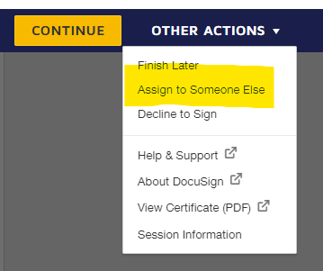
It’s not me?
If you are not the correct person to perform the review action: After selecting the “Start” button in the email, select “Continue” on the ensuing website and then you may assign the role to someone else within your organization by selecting “Assign to Someone Else” from the “Other Actions” drop-down menu. Please note that merely forwarding the email does not assign the role to someone else.
Notes:
Forwarding the email someone else will not remove the assigned role to that person, you will need to assign them through these steps. If a return/revision is made the person assigned will receive the revision.

Slide 11
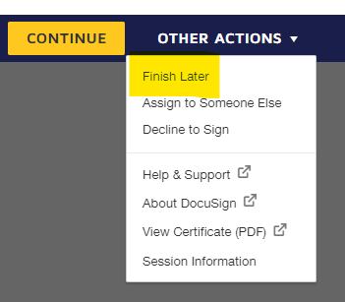
Your Required Action
Select the “Start” button inside the email, then select “Continue” on the ensuing website.
A “Questions” box will appear, it contains our phone number if you need assistance. Click “Continue”.
Review the document and if the document is acceptable:
Owner Reviewer – Click “Yes” and fill in your full name in the required field. (your name is not required for Construction Contracts)
CSFO – Select the appropriate fund source. Fill in your full name in the required field. (your name is not required for Construction Contracts)
If any PSCA funds are being used for the project, the CSFO must choose to decline to sign. The LDP will need to restart the document on the PSCA form.
Owner (Superintendent) apply your e-signature selecting the rectangular “Sign” button on the signature.
Select “Finish” when you are ready for the envelope to forward to the next recipient.
You may also choose to “Finish Later” by clicking on “Other Actions” in the dropdown menu.
If any data is missing or needs revisions, follow the revisions/return instructions.
Notes:
Each email provides instruction for that specific role as well as general information about comments and revisions/returns.
It is important to place your full name in the required field, this will assist future participants to see who the contact is, should they have any questions.
The CSFO will be asked to verify the type of funds being used for the project. If any PSCA funds are used for the project, the CSFO must choose to decline to sign and the LDP will need to restart the document on PSCA forms.
Approval for PSCA funded projects does not route through ALSDE.

Slide 12
Revisions/Returns
Any required fields are outlined in red, and any optional fields are outlined in gray.
Collaborative fields have pink backgrounds; such fields are initially filled out by the LDP Form Filler. All participants can change these fields during the process.
If you make changes to any collaborative field or return field and complete your turn, the document will return to the LDP Form Filler to review and initial the change. It will then proceed to the next person in sequence.
Notes:
If you make changes to a field that is not outlined in red, the document will route back to the LDP form filler for review and approval of the change. The LDP form filler can also make additional changes.
Returns/Revisions will route to all participants that have already viewed and performed their action prior to the change. It will require each participant’s initials on the far-right hand side of the document where the change was made.

Slide 13
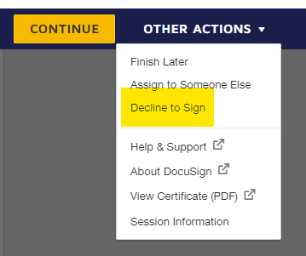
Decline to Sign or Void
Selecting “Decline to Sign” or “Void” would terminate the document and render the draft unusable.
Notes:
Declining to Sign or Voiding will terminate the document and it cannot be accessed after the action is taken.

Slide 14
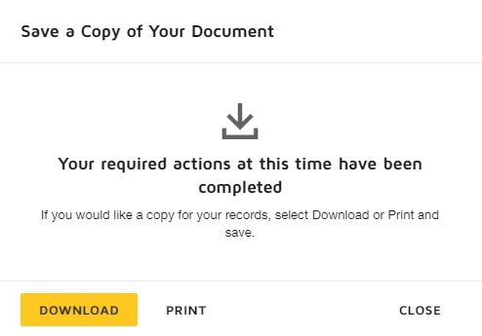
Fully Executed
You will have the option at the end of your turn to download a copy of the document.
Once all recipients have completed their turn, each will automatically receive either an emailed link to a fully signed document, OR an emailed notice of a voided document.

Slide 15
Notice to Proceed
Notice to Proceeds are currently being issued by the LEA or LDP. This will continue. Please ensure that the Notice to Proceed is issued. This is a vital piece for projects to be completed on time.

Slide 16
Transition/Grace Period
We understand that there are original hard copy documents in the routing process. We will accept original hard copies for a short duration of time to allow these documents to be submitted.
The hard deadline will be for Agreements between the Owner and Architect/Engineer and Construction Contracts dated on or after October 1, 2022. These documents will be returned to the LDP for submission through the DocuSign process.
Notes:
We will release a notification when we are no longer accepting hard copies.

Slide 17
Questions or Assitance
If you have any questions or need assistance, please contact:
Alabama State Department of Education
School Architect Section
334-694-4602
jragan@alsde.edu

