Slide 1
Contractor’s Exemption Legislative Act No. 2013-205
Effective
1/1/2014

Slide 2
Act 2013-205 (HB 419)
Governmental Entity Project (Contractor’s) Sales and Use Tax Exemption
This act provides a sales and use tax exemption for contractors and subcontractors on purchases of building materials, construction materials and supplies, and other tangible personal property that becomes part of the structure that is the subject of a written contract for and on behalf of exempt governmental entities, with the exception of any highway, road, or bridge project.

Slide 3
Statute & Departmental Rules
Section 40-9-14.1, Code of Alabama, 1975
Certificates of exemption to governmental entities, contractors, etc., for certain tax exempt projects.
Rule 810-6-3-.77
Exemption for Certain Purchases by Contractors and Subcontractors in Conjunction with Construction Contracts with Certain Governmental Entities

Slide 4
Governmental Entity Defined
The State of Alabama and its political subdivisions
including a county, a municipality, and an industrial or economic development board or authority.
An educational institution of any of the foregoing Alabama political subdivisions
including a public college or university, a county or a city board of education, and the State Board of Education.
Please note that this term does not include the federal government.

Slide 5
Not Exempt
Federal government
Governmental entity that is not itself exempt from Alabama sales and use taxes
Highway, road, and bridge jobs on the behalf of any governmental entity
Tangible personal property not incorporated into real property such as supplies, equipment, etc
Private schools
Out-of-state governmental entities

Slide 6
Effective Dates
Effective Date: Oct. 1, 2013. For contracts entered into on Jan. 1, 2014, and thereafter.
This act will not apply to any contract entered into prior to Jan. 1, 2014, nor to change orders or contract extensions, including revised, renegotiated, or altered contracts, when the original contract was entered into prior to Jan. 1, 2014.

Slide 7
Overview of Procedure
Governmental entity shall complete application EXC-01 for a sales and use tax certificate of exemption (ST:EXC-01) for each tax exempt project in order to qualify the project
Contractors and subcontractors licensed by the State Licensing Board for General Contractors shall also apply for ST:EXC-01
ST:EXC-01 for making qualified purchases for the project listed on the certificate

Slide 8
Procedure
Exempt Entities are required to submit an application (Form ST:EXC-01) and provide a copy of the contract for each project in order to qualify the project for the exemption.
A unique project number will be assigned to each project.
The General Contractor is required to submit an application, a copy of the contract showing they were awarded the bid, and a list of all subcontractors working on the project. In the event that the list of subcontractors changes, the General Contractor is required to notify the Department within 30 days of the changes.
Every subcontractor working on a qualifying project will be required to apply using Form ST:EXC-01 for each project in order to be awarded an exemption certificate.
Sub-contractors are not required to apply if they are labor only and will not be purchasing materials

Slide 9
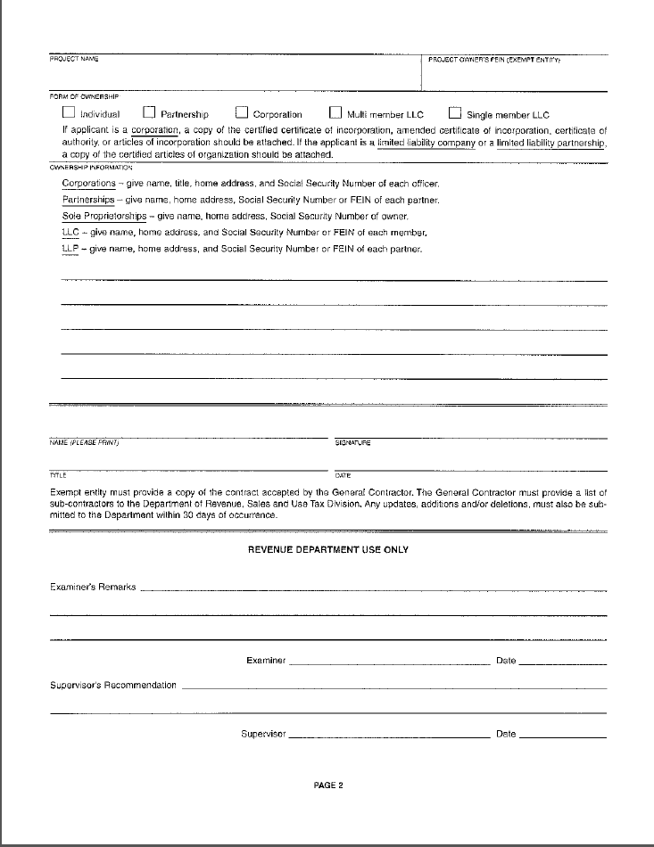
Form ST:EXC-01 Governmental Entity Project (Contractor’s) Sales & Use Tax Exemption Application

Slide 10
Governmental Entity Project (Contractor’s) Sales & Use Tax Certificate of Exemption

Slide 11
NOTE: Dates of Issuance
Exemption Certificates will be issued as of the project start date or the received date of the application. If, upon receipt of the application, the project has already commenced, the certificate will be issued as of the received date of the application.
Any purchases made prior to the issuance of a certificate will not be exempt.

Slide 12
Contractor’s Responsibilities
Notify Department of any changes to the contract and/or any changes, additions/deletions to the list of sub-contractors
Maintain records sufficient to document the tax exempt status of qualified purchases
Must make a report of all exempt purchases to the Department in the manner prescribed by the Department
Report of exempt purchases prerequisite to renewal of a certificate of exemption
Failure will result in an assessment against the contractor and/or sub for the amount of sales & use taxes on any items purchased with the certificate.

Slide 13
Consumer Use Monthly Reporting Requirements
Each contractor and subcontractor awarded the exemption will be assigned a Consumer Use Tax account where monthly filing will be required.
Separate entries will be made for each exempt project which identify monetary material amounts that are purchased tax free using the certificate of exemption.
Once the account is assigned, the monthly filing is required even if no purchases were made during the month.

Slide 14
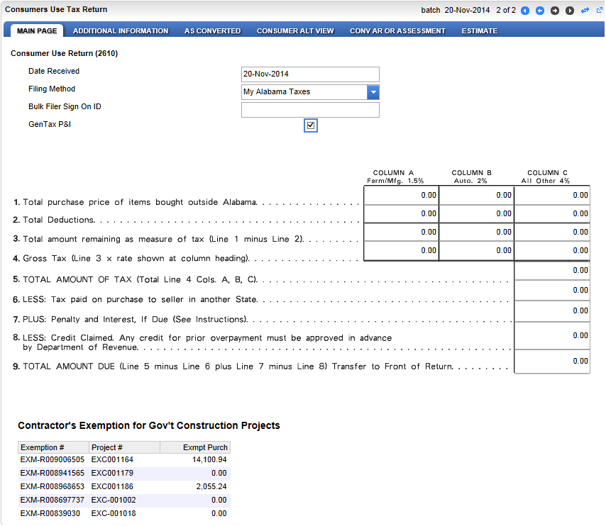
CNU Reporting Requirements

Slide 15
Reporting Problems
Taxpayer calls to close the CNU account
T/P enters amount purchased that should be exempt in line 1 of the CNU return and pays tax on materials
T/P does not file the report at all
T/P leaves off some projects but reports others
T/P does not file through dates listed on certificate
For example, if the certificate’s effective date is June 29, 2014 and the expected completion date is October 1, 2014, a consumer’s use tax return must be filed for each of the following months: June, July, August, September, and October

Slide 16
Dual Businesses
Dual businesses are required to apply for sales and use tax certificate of exemptions per job
Reporting requirements must be complied with

Slide 17
Penalties
Intentional misuse, in addition to actual sales or use tax due, subject to civil penalties
A minimum of $2,000 or 2 times any state and local sales or use tax due for the property and,
Based on the contractor's or subcontractor's willful misuse of the certificate of exemption, may be barred from the use of any certificate of exemption on any project for up to two years.
Right to appeal in accordance with Section 40-2A-8, Code of Alabama 1975

Slide 18
Appeals Process
If Department denies the applicant an exemption:
Contractor may appeal in accordance with 40-2A-8.

Slide 19
How Contractor’s Exemption Can Affect Utility Contractors
Expands exempt items used on pollution control jobs in respect to State of Alabama, county and municipal contracts as well as any other governmental entity that is exempt from sales & use taxes
Exception: Road and bridges that are a part of a DOT road project
Note: Agency agreements can still be entered into for non-qualifying jobs

Slide 20
Contractor’s Exemption/Pollution Control Qualified Governmental Entities
Will all permanent materials installed inside the facility fenced area be tax exempt, including asphalt or concrete parking areas used solely for the treatment facility?
Answer: Yes
Will the access road to a wastewater treatment facility or a water treatment facility built solely for the use to access the facility be considered tax exempt?
Note: Some treatment facilities are built a long distance from the public road.
Answer: Yes—as long as it is included in the utility job and not a DOT project

Slide 21
ALDOT Contracts
Contractor has a contract with ALDOT (or any governmental entity) to do highway, road or bridge work. Part of that contract requires the moving, replacing, maintenance, or any other water and sewer lines/work. Is the job exempt?
The only way for the water/sewer work to be exempt is if there is a separate contract for just the water/sewer work.

Slide 22
Further Clarification
If there is a separate contract for water/sewer work, the contract would qualify for the “governmental entity contractor’s exemption” and ALDOT and the contractor would be required to obtain the exemption certificate to participate in that exemption and anything going becoming a part of the “structure” would be exempt.
If there is no separate contract for the water/sewer work, the contractor and ALDOT could use the Purchasing Agent Agreement and the exemption would be limited to pollution control laws.

Slide 23
Utility Job Contract with an Exempt Governmental Entity
Contractor has a contract with an exempt governmental agency that qualifies for the project exemption. The job is a utility job installing, moving, replacing, etc. water/sewer facilities. Part of the contract requires the contractor to lay asphalt and/or perform other road work in order to perform the utility work.
Even though this contract contains road work, it is a utility contract with the majority of the contract being something other than road work; therefore, the entire contract would qualify for the exemption and would not be ineligible because of the roadwork.
This would include access roads as long as the work done is a minor part of the contract with the exempt governmental entity and not contract with DOT.
The entity and the contractor could obtain the exemption certificates for the project.

Slide 24
Pollution Control Qualified Governmental Entities
Will concrete grout used for filling abandoned sanitary sewer lines be tax exempt?
Answer: Yes

Slide 25
Private Developers Non-Exempt Government Jobs
If a developer builds his own treatment facility, is the material used on the project tax exempt?
Yes. The materials that will be incorporated into a structure in which the pollution control function takes place are exempt.
Materials that will be incorporated into the realty but not into the structures in which the pollution control function takes place, such as materials for structures built for ancillary purposes, asphalt for the parking lot, and fencing, are taxable

Slide 26
Silt Fences
Is the silt fence used on sewer projects exempt?
No—Taxable as a material used by the contractor not becoming a component part of the project nor incorporated into realty

Slide 27
Storm Drains
Will storm drain lines be tax exempt if they have a filter system installed? If not, what would be required to make it tax exempt?
The system has been identified as storm drains so it fails to pass the primary purpose test for pollution control. If the filter system consists of grates to catch large items in order for the drains to flow, the filters would not qualify.
Yes, if installed into a qualified exempt project for a governmental unit or school of the State of Alabama, municipality, county

Slide 28
Exemption Certificates
If claiming an exemption pursuant to the Contractor’s exemption
A sales and use tax certificate of exemption is required per exempt job
Tax due on ancillary buildings, etc. if procedures not followed
The pollution control exemption does not require an exemption certificate but exempt status is limited to pollution control equipment per prior rules

Slide 29
Rural Water Systems: Public Corporations--Not Gov’t Agency
Rural Water Systems can have hundreds of miles of pipe with fewer customers. These systems often require water booster stations, and depending on the system requirements, some may require a chlorination unit added to help treat the water.
a. Is the chlorination unit tax exempt?
Yes, primary purpose eliminate bacteria.
b. If so, would the pump station and apparatus be tax exempt?
No, primary purpose deliver water to customers.

Slide 30
Sewer Systems for Qualified Governmental Jobs
The sewer system, including all pipes, pumps, etc. that carry the wastewater from the point the sewer connects to the pipe from the home or building to the point of discharge, is exempt.
The WWTP, building or structure, and the devices, and identifiable components thereof, acquired primarily for the control, reduction or elimination of water pollution are exempt.
Equipment that does not have a function in the treatment of the wastewater is exempt.
Building materials purchased for the construction of the parking lot and fence are exempt

Slide 31
Government Utility Service
Would the Pollution Control tax exemption policies apply to a GUS (Government Utility Service) --a consortium of a municipality and a private company working together to provide pollution control?
Yes, when a private company is in the business of providing management services to a GUS by operating a waste treatment or wastewater treatment facility, the company may purchase equipment and materials that function to control, reduce or eliminate water pollution exempt from tax. The exemption is limited to the pollution control exemption.

Slide 32
Would the pollution control tax exemption policy apply to a private firm providing wastewater treatment for a municipality? A private developer/owner?
Yes—subject to the limitations of the pollution control exemption—not subject to expanded exemption per Contractor’s Exemption for Construction Contracts with Certain Governmental Entities

Slide 33
Is everything that goes into the production of a sewer line tax exempt including the off road fuel that goes into the machinery and the gravel used in the project?
No. It is the materials that go into the structure and supplies used to directly treat pollution that are exempt, not supplies which are used during construction.
New law change does not affect taxability of supplies used by the contractor

Slide 34
Important Reminder
The report of exempt purchases shall be a prerequisite to the renewal of a certificate of exemption.
Failure to report the exempt purchases will result in an assessment against the contractor or subcontractor for sales and use taxes on any items purchased with the certificate of exemption.

Slide 35
Questions?
“The wise man doesn’t give the right answers, he poses the right questions.”
-Claude Levi-Strauss

